Slide 1
Sideline
Sweetheart
Cascade High School
Virtual Cheer Competition
CLICK PRESENT in top right corner

Slide 2
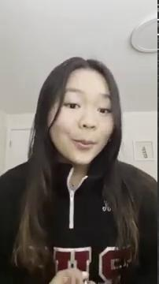
Welcome to our
Varsity Individual
Awards Ceremony

Slide 3

Individual Awards

Slide 4
Are

Slide 5
You

Slide 6
Ready?

Slide 7
First...
A word about YOUR Cheer Talent

Slide 8
Band Dance

Slide 9
Band Dance
From the judges:
Great controlled, sharp motions. Awesome job pumping up your crowd before you started. Great facials!
From Vineland HS
Melia G

Slide 10
Band Dance
From the judges:
Great performance and facials. Nice sharp motions that hit! Way to go pumping up your crowd beforehand!
From Vineland HS
Melina G

Slide 11
Band Dance
From the judges:
Excellent dancing. Sharp, strong motions.
From Service HS
Madellyn T

Slide 12
Band Dance
From the judges:
Nice sharp, strong motions. Great energy and sass.
From Service HS
Abbi G

Slide 13
Band Dance
From the judges:
Great sass, energy and attitude. Great dancing! The beginning and the ending pose served it!
From Service HS
Sentha W

Slide 14
Band Dance
From the judges:
Great dancing! Sharp, tight movement and motions. Great performance!
From Service HS
Kinley K

Slide 15
Offense Cheer

Slide 16
Offense Cheer
From the judges:
Great Job! Strong, sharp motions! Great smile!
From Mabel-Canton Varsity
Katelyn K

Slide 17
Offense Cheer
From the judges:
Great voice! Nice clean motions! Great job!
From Campus International HS
Makayla B

Slide 18
Offense Cheer
From the judges:
Way to work the "imaginary" crowd! Great movement, great energy, sharp motions!
From Vineland HS
Melia G

Slide 19
Offense Cheer
From the judges:
Great energy and voice. Great movement to the cheer and nice sharp attack on the motions!
From Huntington HS
Phoebe C

Slide 20
Offense Cheer
From the judges:
Excellent! The energy! The motions! Everything hit sharp. Great job!
From Service HS
Aubrey M

Slide 21
Offense Cheer
From the judges:
Great job! Clean, sharp motions and movements. Fun for the crowd. Great voice and you brought the energy.
From Service HS
Claudia L

Slide 22
Defense Cheer

Slide 23
Defense Cheer
From the judges:
Great energy and voice! Strong motions!
From Service HS
Trinity H

Slide 24
Defense Cheer
From the judges:
Excellent crowd leading movements! Sharp, strong motions. Great performance!
From Vineland HS
Melina G

Slide 25
Defense Cheer
From the judges:
Great job! Strong motions. Great voice.
From Service HS
Brooke B

Slide 26
Timeout/Spirit Cheer

Slide 27
Timeout Cheer
From the judges:
Strong, sharp motions! Beautiful kick! Great voice and energy! Consistent throughout!
From Huntington HS
Phoebe C

Slide 28
Timeout Cheer
From the judges:
Great sign work! Way to work the "crowd". Great voice and energy throughout! Nice jump!
From Service HS
Claudia L

Slide 29
Timeout Cheer
From the judges:
Excellent! Strong, sharp motions. Great voice. Great jump!
From Vineland HS
Melina G

Slide 30
Fight Song

Slide 31
Fight Song
From the judges:
Great crowd leading words! Nice clean, sharp motions!
From Vineland HS
Kayla G

Slide 32
Fight Song
From the judges:
The extra bounce while performing brings your fight song alive! Nice strong motion work! Great performance!
From Mabel-Canton Varsity
Katelyn K

Slide 33
Fight Song
From the judges:
Great voice, great energy! Clean, sharp motions! Great crowd leading!
From Huntington HS
Phoebe C

Slide 34
Fight Song
From the judges:
Clean, sharp motions! Great crowd leading!
From Huntington High School
Claira R

Slide 35
Congratulations
to all of our
Award winners!

Slide 36
Now it’s time for….
Ultimate
Sideline
Sweetheart
Cheerleader
Awards

Slide 37

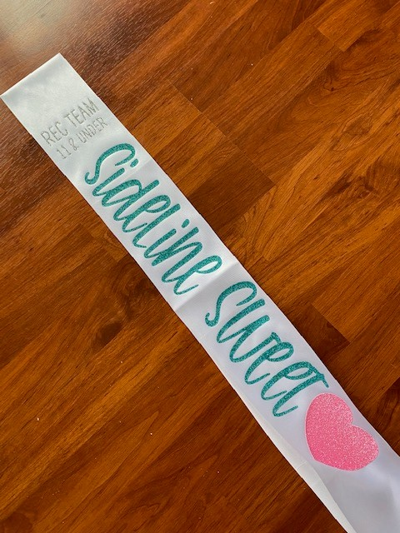
Ultimate
Sideline
Sweetheart
Varsity Winners
Will Each Receive...
It won’t say “REC TEAM”, it will say VARSITY! :)

Slide 38
With SOOOOO much talent...

Slide 39
Varsity Ultimate Sideline Sweetheart
From Service HS
Aubrey M

Slide 40
Varsity Ultimate Sideline Sweetheart
From Vineland HS
Melina G

Slide 41
Varsity Ultimate Sideline Sweetheart
From Vineland HS
Melia G

Slide 42
Varsity Ultimate Sideline Sweetheart
From Huntington HS
Phoebe C

Slide 43
Varsity Ultimate Sideline Sweetheart
From Mabel-Canton Varsity
Katelyn K

Slide 44
Congratulations!
All sashes, individual category awards and tshirts will be mailed out sometime next week!

Slide 45
Thank you for competing with us!

Slide 46
Presentation Template: SlidesMania
Images: Unsplash
Please keep this slide or mention us and the other resources used in the footer of a slide.

