Slide 1
Sideline
Sweetheart
Cascade High School
Virtual Cheer Competition

Slide 2

Welcome to our
High School Team
Awards Ceremony

Slide 3
Team Awards

Slide 4
Are

Slide 5
You

Slide 6
Ready?

Slide 7
Band Dance

Slide 8
Band Dance JV
From the judges:
Great dancing! Clean, tight motions! Super fun!
Service HS

Slide 9
Band Dance Junior High
From the judges:
Great job crowd leading on the "Hey Go Cougars!" Great energy! Good job!
SC Lee JH

Slide 10
Varsity Building
From the judges:
Great energy! Great synch! Great use of signs and meg to crowd lead!
Lakeland HS

Slide 11
Varsity Non-Building
From the judges:
Great sign work! Awesome synch and sharp, tight motions!
Vineland HS

Slide 12
Offense/Defense Cheer

Slide 13
Offense/Defense JV
From the judges:
Great cheer, great energy! Clean motions.
American Canyon HS JV

Slide 14
Offense/Defense Junior High
From the judges:
Great ripples! Great meg work! Awesome synch on motions!
St John the Baptist JH

Slide 15
Offense/Defense Varsity Building
From the judges:
Great ripples! Great meg work! Awesome synch on motions!
Lakeland HS

Slide 16
Offense/Defense Varsity Non-Build
Norte Vista HS
From the judges:
"Charge, you say Charge" - the cheerleaders who lean towards the crowd give that life! Nice voice and energy! Great job!

Slide 17
Offense/Defense Varsity Non-Build
From the judges:
Great synch, nice attack on motions. Energetic throughout!
Huntington HS

Slide 18
Timeout/Spirit Cheer

Slide 19
Timeout Cheer JV
From the judges:
Great incorporation of signs. Nice clean motions. Great beginning!
Service HS

Slide 20
Timeout Cheer Junior High
From the judges:
Great energy, great voice! Everything was clean, sharp and on point. Excellent job!
St John the Baptist JH

Slide 21
Timeout Cheer Varsity Build
From the judges:
Great job crowd leading! Nice clean stunt! Great sign work. Visually appealing!
Mabel-Canton HS

Slide 22
Timeout Cheer Varsity Non-Build
From the judges:
Easy callbacks for the crowd. Great work engaging different parts of the "crowd". Great energy!
Eastmont HS

Slide 23
Timeout Cheer Varsity Non-Build
From the judges:
Nice clean synchronized motions. Great crowd leading with signs!
Del Oro HS

Slide 24
Timeout Cheer Varsity Non-Build
From the judges:
Excellent use of props! Great tumbling! Nice level changes.
Service HS

Slide 25
Fight Song

Slide 26
Fight Song JV
American Canyon HS JV
From the judges:
Great job! Beautiful kick! Clean motions! Great smiles!

Slide 27
Fight Song Junior High
From the judges:
Excellent job! The video could have stopped at any moment and your motions would have been in sync! Sharp, clean motions were consistent. Great tumbling!
SC Lee JH

Slide 28
Fight Song Varsity Build
From the judges:
Love the jump ripple! Great energy! Nice clean motions!
Mabel-Canton HS

Slide 29
Fight Song Varsity Non-Build
American Canyon HS
From the judges:
Great energy!!! Nice sharp, tight motions! Great dancing!

Slide 30
Fight Song Varsity Non-Build
From the judges:
Great job here! Sharp motions, and synch! Looked so good!
Viewpoint HS

Slide 31
Congratulations to all our
Team Award winners!

Slide 32
Now it’s time for….
Ultimate
Sideline
Sweetheart
Team
Awards

Slide 33

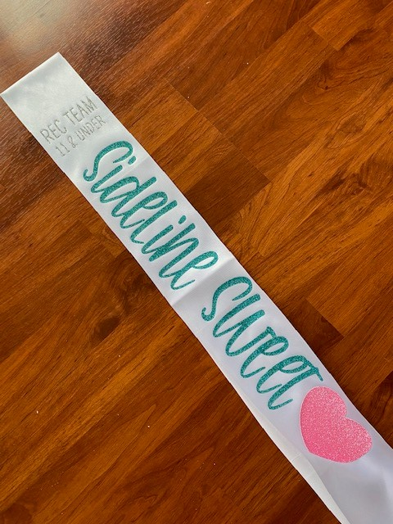
Ultimate
Sideline
Sweetheart
Junior Varsity Team
Junior High Team
Varsity Building Team
Varsity Non-Building Team
Will Each Receive...

Slide 34
Ultimate Sideline Sweethearts
Team

Slide 35
JV Ultimate Sideline Sweethearts
American Canyon HS

Slide 36
Junior High Ultimate Sideline Sweetheart
SC Lee Junior High

Slide 37
Varsity Build Ultimate Sideline Sweetheart
Mabel-Canton HS

Slide 38
Varsity Non-Build
Ultimate Sideline Sweetheart
Robert Service HS

Slide 39
Congratulations!

Slide 40
All awards, Ultimate Sweetheart Sashes, Tshirts, etc will be mailed out sometime next week.
Thank you so much for competing with us!
Great job everyone!

Slide 41
Presentation Template: SlidesMania
Images: Unsplash
Please keep this slide or mention us and the other resources used in the footer of a slide.

