Slide 1


Positive Behavior Interventions & Supports
PBIS
MABEL-CANTON SCHOOL

Slide 2
Mission Statement
Mabel-Canton is a community that treats each other with respect, takes responsibility for our learning and strives for a safe and positive environment for all.

Slide 3
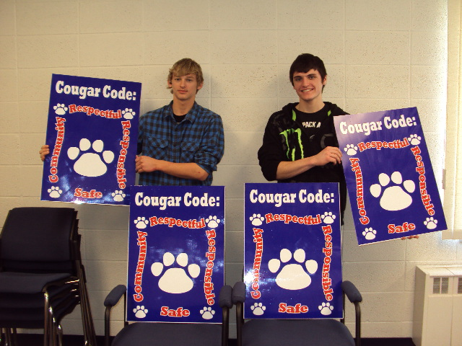
Cougar Code
Be Respectful
Be Responsible
Be Safe
Be a Community

Slide 4
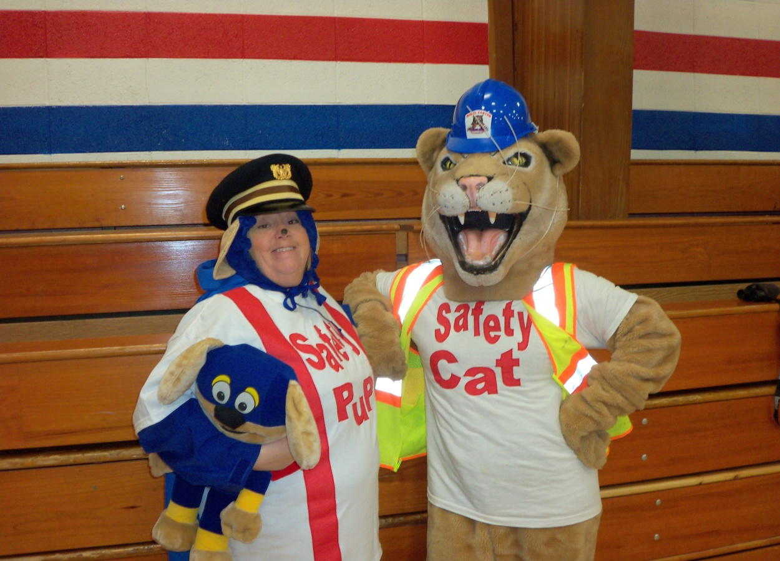
What is PBIS?
POSITIVE
BEHAVIOR
PBIS is a new program at Mabel-Canton School that is focusing on improving the academic achievement of our students.

Slide 5
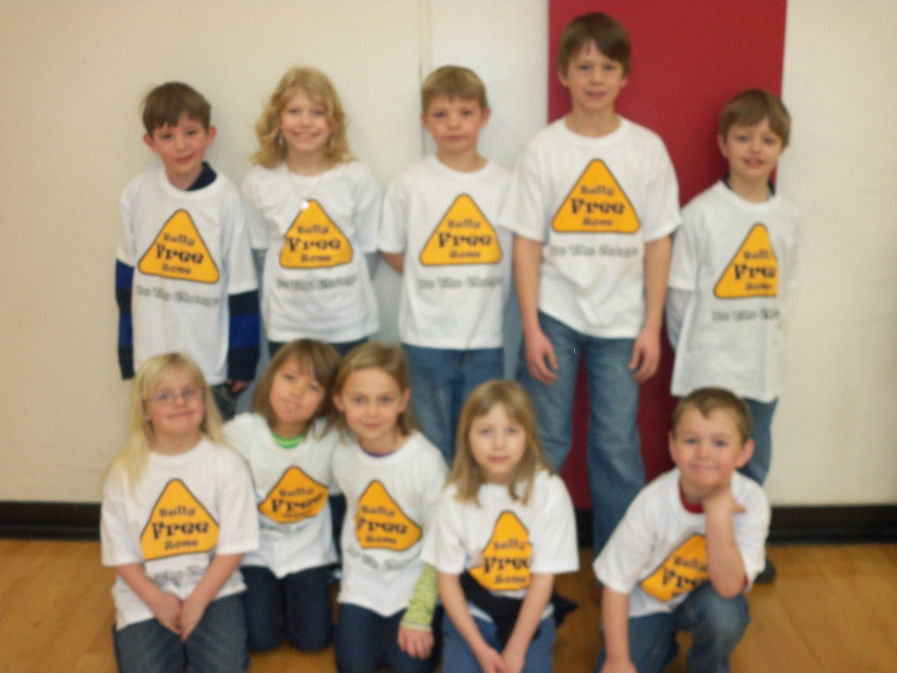
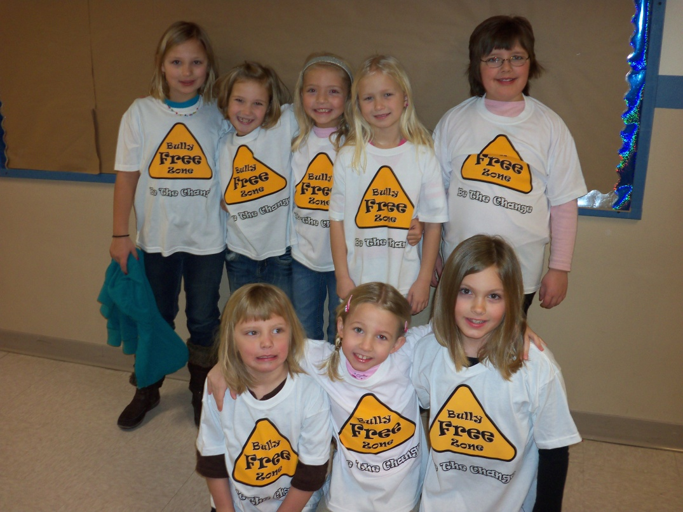
What is PBIS?
POSITIVE
BEHAVIOR
A special effort is being directed toward improving the social and behavioral climate in our school.

Slide 6
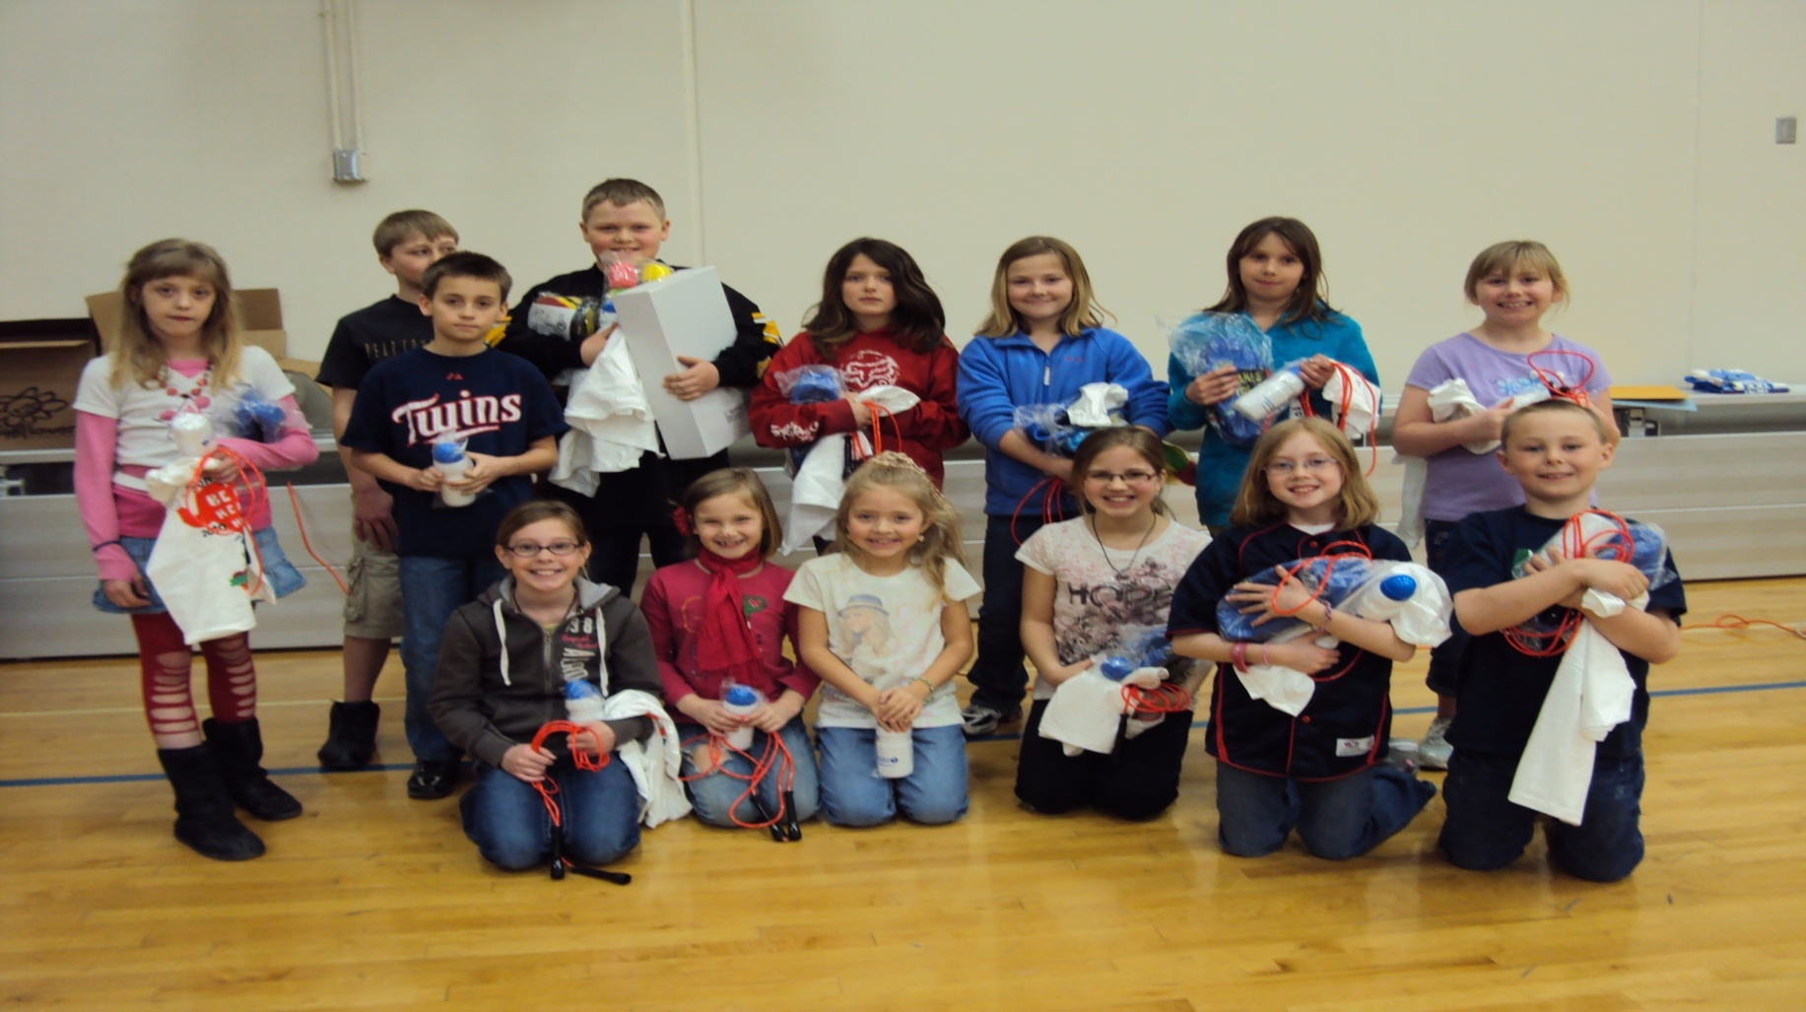
What is PBIS?
POSITIVE
BEHAVIOR
EVERYONE is involved in PBIS – teachers, support staff, students, parents and community

Slide 7
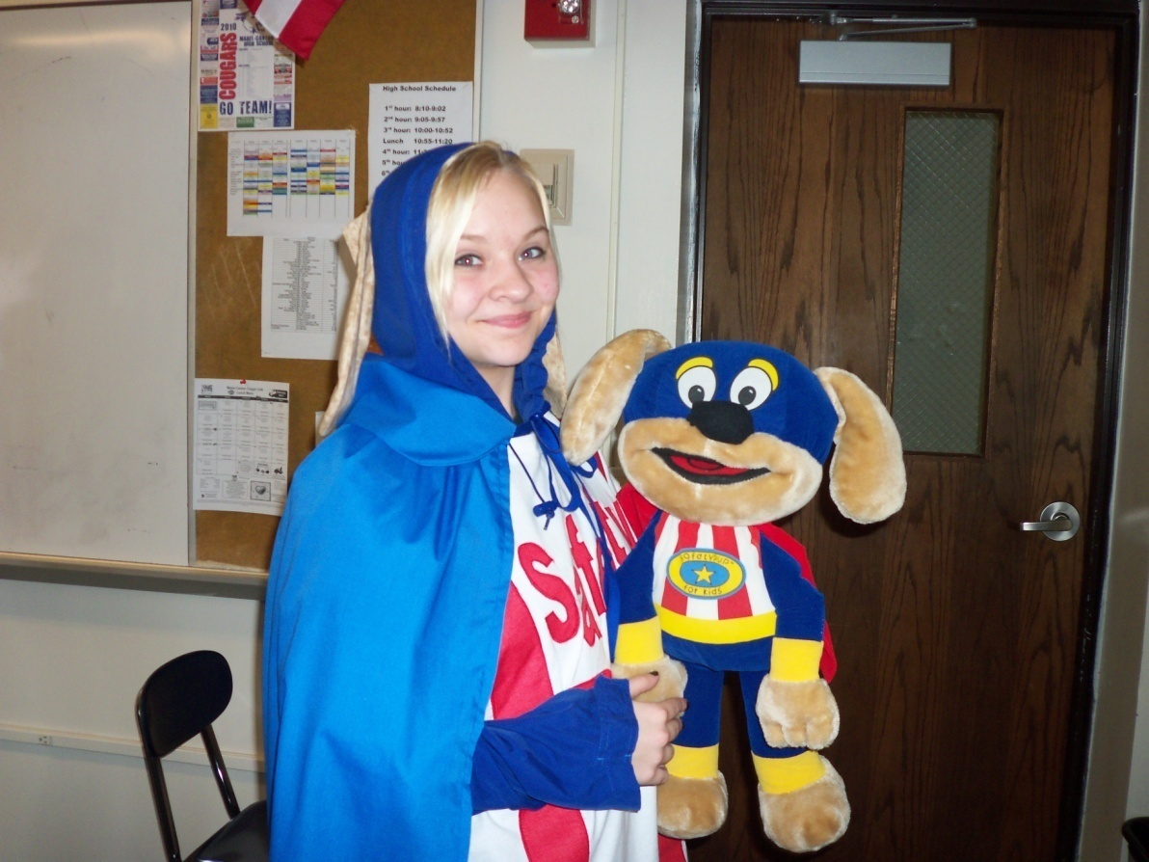
Behavior Focus Areas
Bathroom
Bus
Playground
Hallway
Lunchroom
Office
Library
Assemblies
Computer Lab
Sporting Events

Slide 8
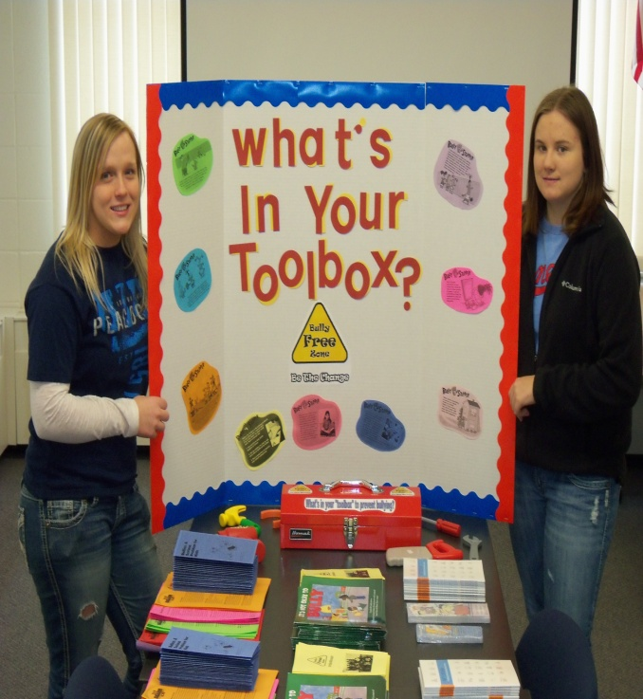
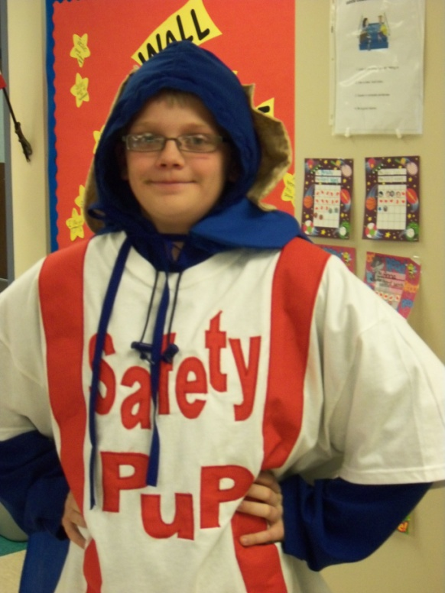
Keep checking the “PBIS Link” on the Mabel-Canton School Website to stay updated on the
“Cougar Code News”

